Slide 1
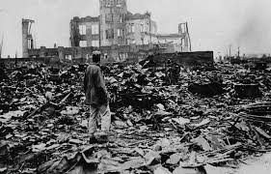
Hiroshima – Nagasaki Aout 1945 NEVER AGAIN!

Slide 2
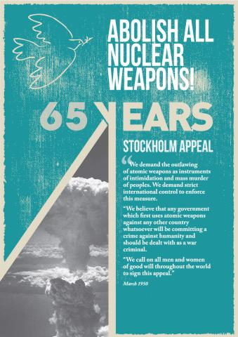
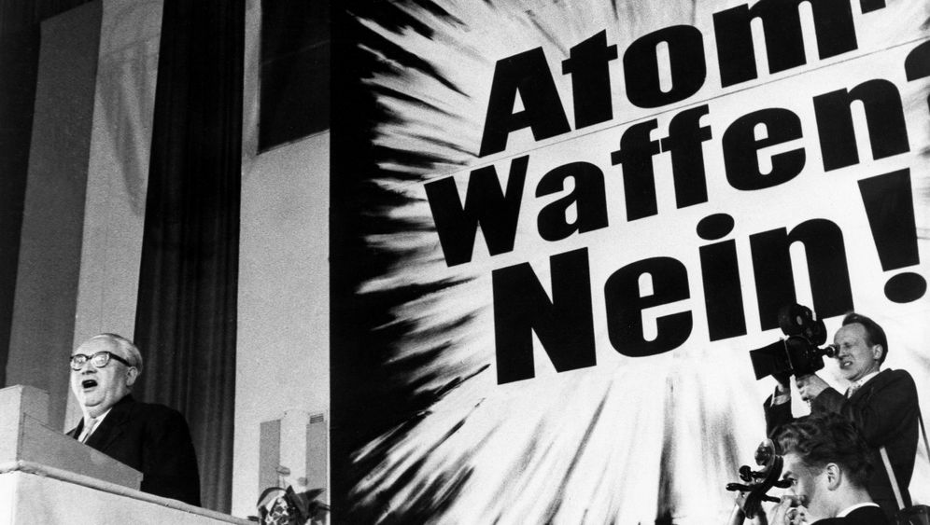
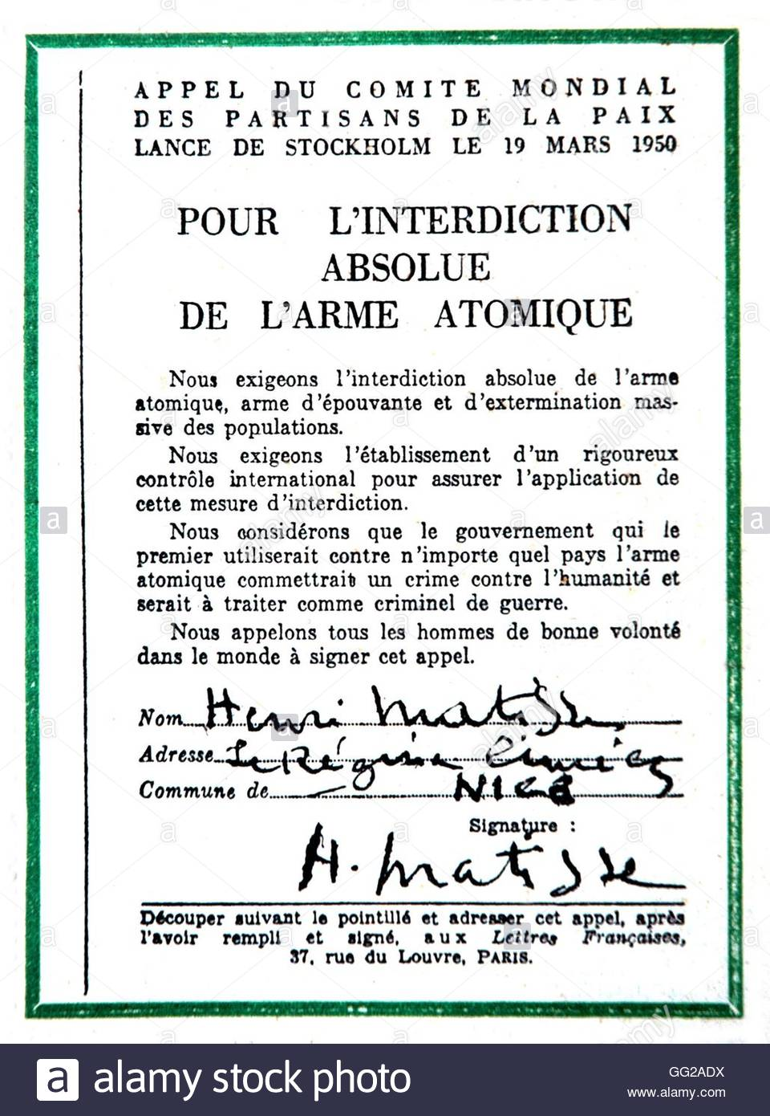
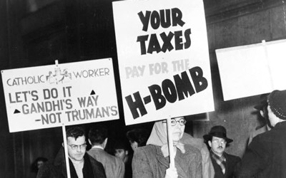
Stockholm Appeal : 3 million signatures

Slide 3
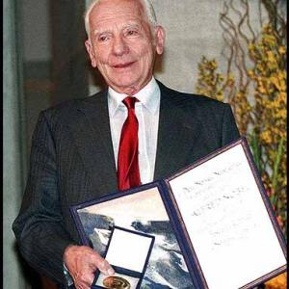
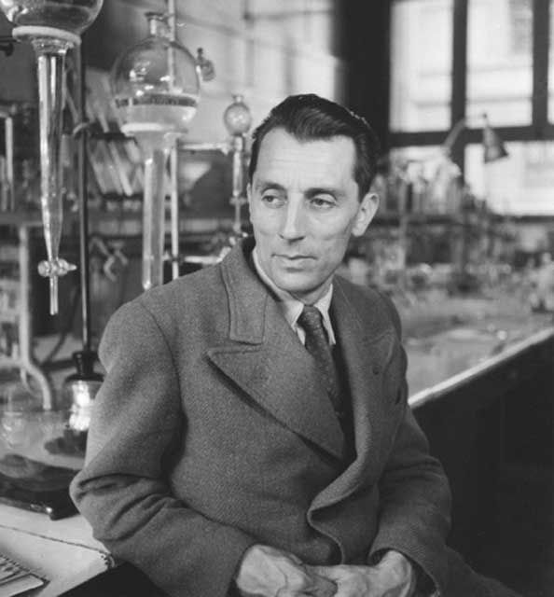
« Remember your humanity, and forget the rest »: Russel-Einstein Manifesto : Scientists against the bomb

Slide 4
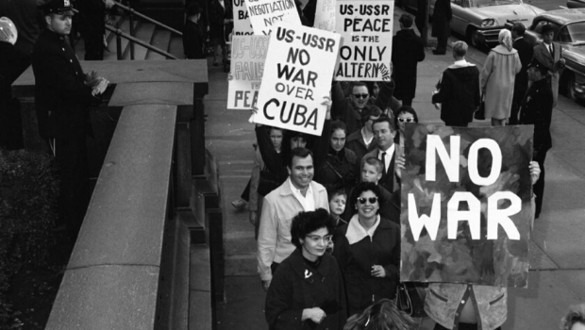
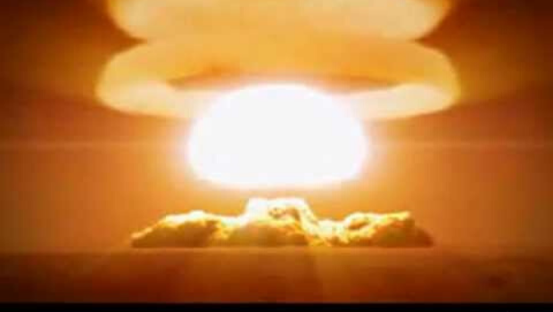
60’s: Mutual Assured Destruction Anti-nuclear movement becomes a global mass movement

Slide 5
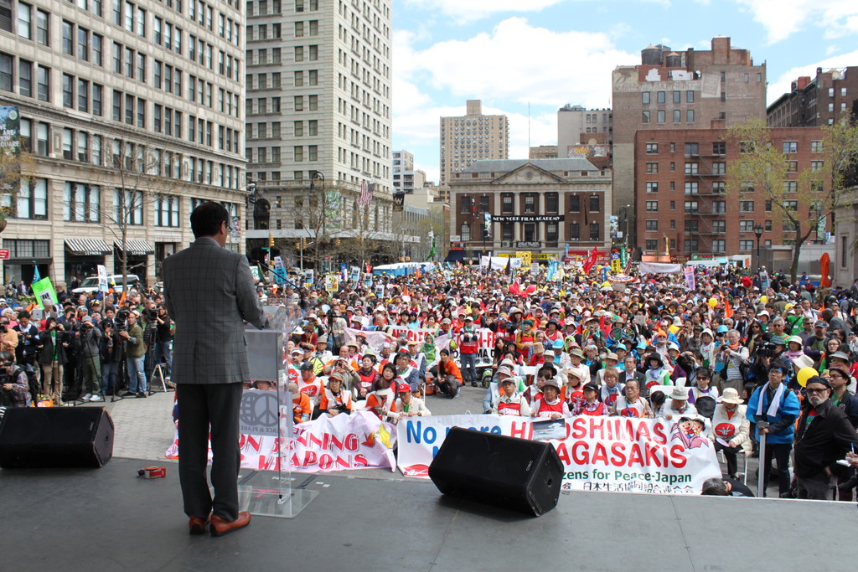
68: The Non Proliferation Treaty: « corner stone »…
Notes:
1 July 1968
Non-Proliferation Treaty opens for signature
Under the Nuclear Non-Proliferation Treaty, non-nuclear-weapon states agree never to acquire nuclear weapons, and the nuclear-weapon states make a legal undertaking to disarm.

Slide 6
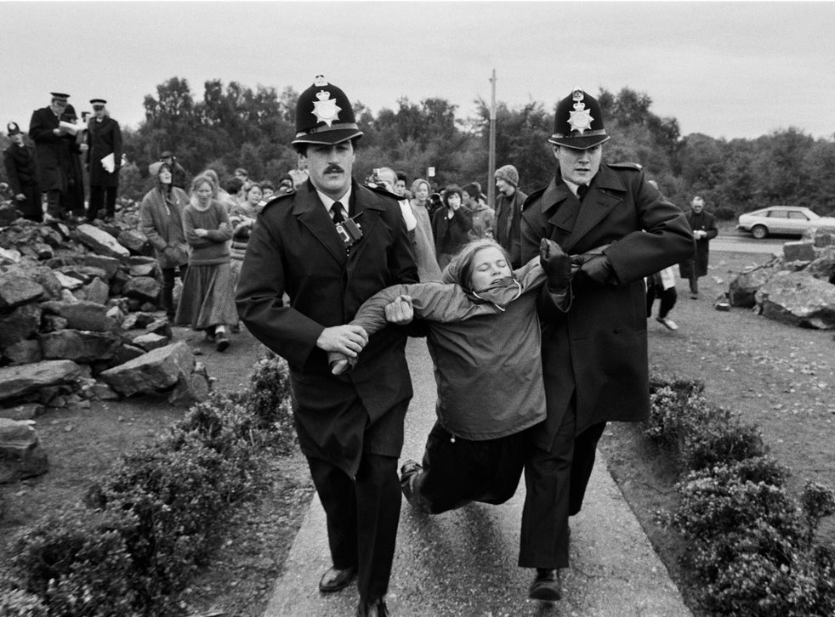
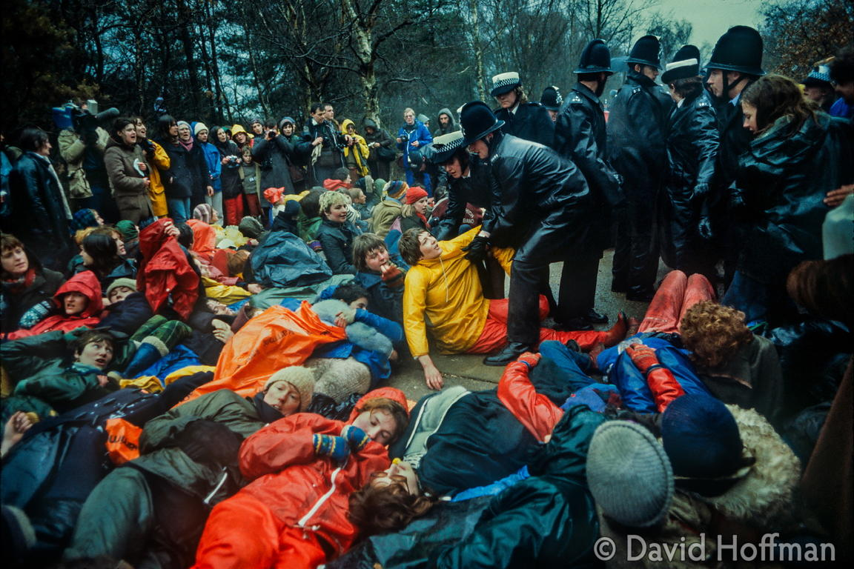
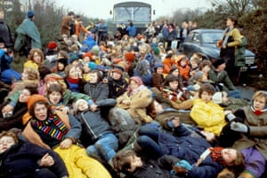
48 weeks occupation : Women kick US missiles out!
Notes:
Greenham Common is the illustration of a strong and winning feminist pacifism

Slide 7
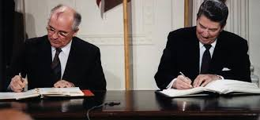
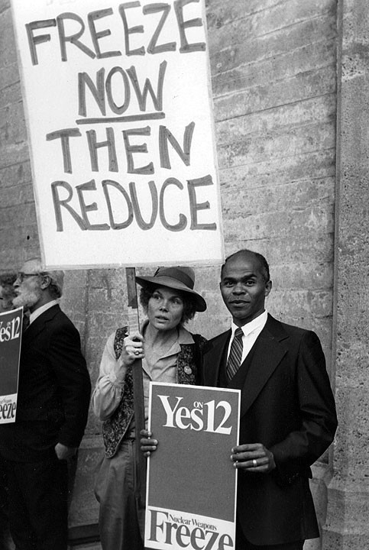
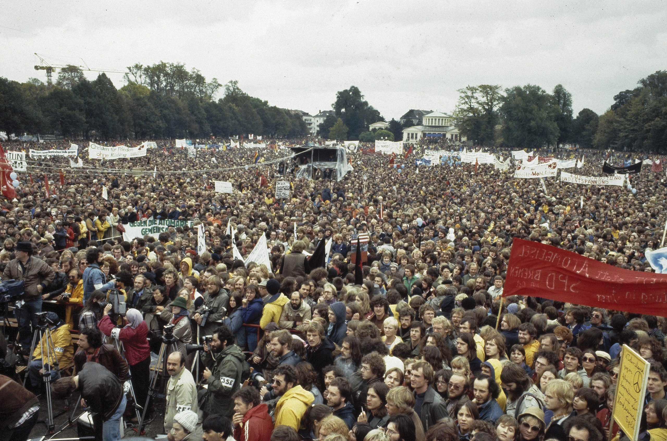
80’s : biggest ever demos!

Slide 8
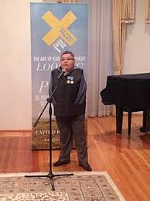
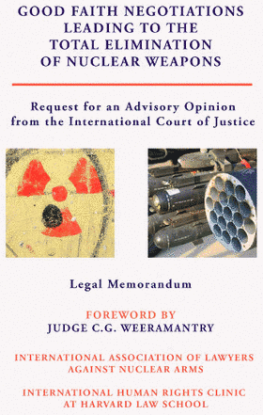
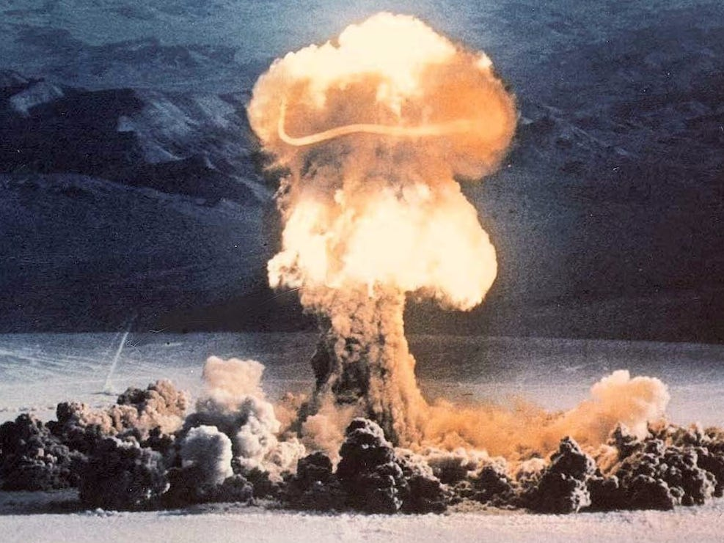
Post Cold War improvements: CTBT - ICJ

Slide 9
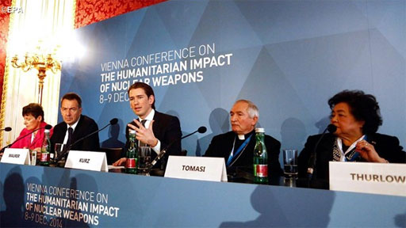
« The humanitarian initiative »

Slide 10
2021: NUCLEAR WEAPONS BANNED

