Slide 1
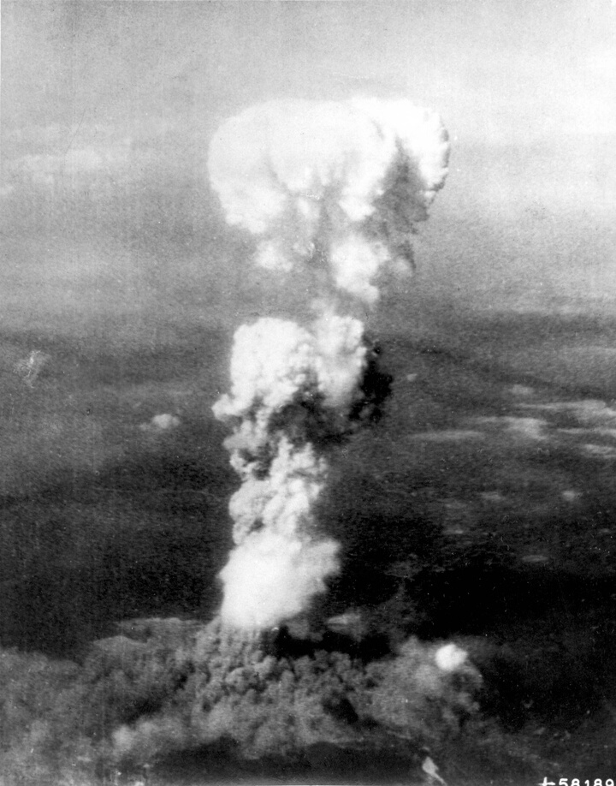
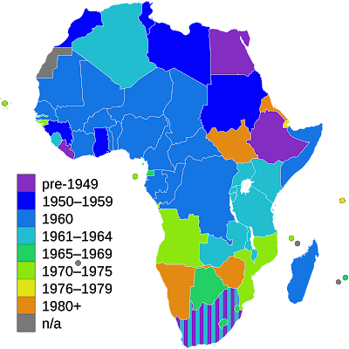
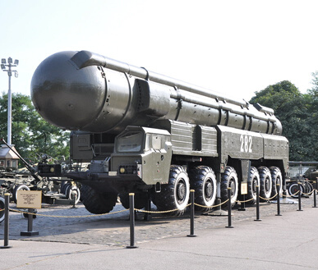
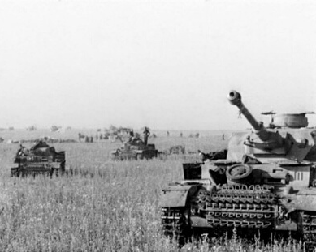
Confrontation between the USSR and the USA increases.
The North Atlantic Treaty Organization is founded.
The People's Republic of China is founded.
1945-1960
AUG 6 1945
1949
1945–1960
1949
AUG 1949
OCT 1949
USA drops the first atomic bomb on Hiroshima, beginning the Atomic Age.
Decolonization period in Asia and Africa.
The Soviet Union unveils its nuclear bomb and a period of deterrence begins.

Slide 2
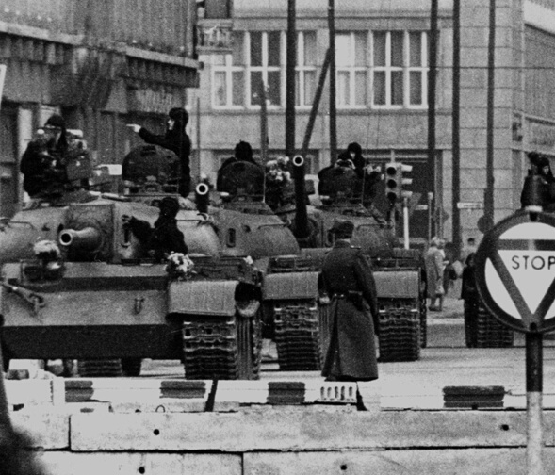
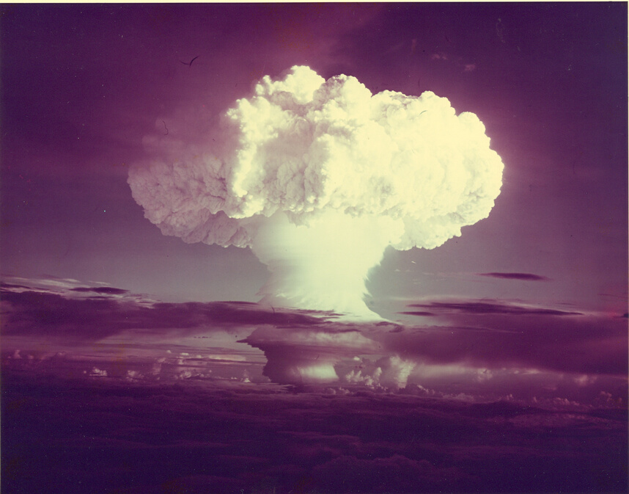
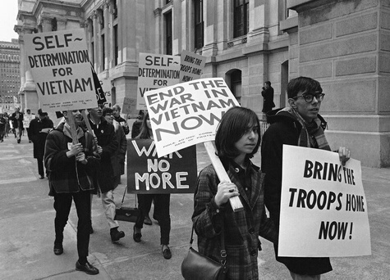
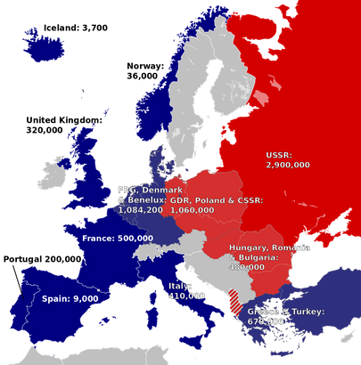
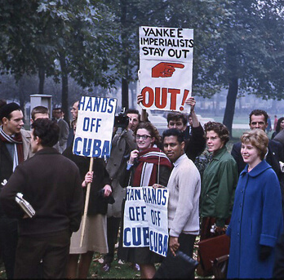
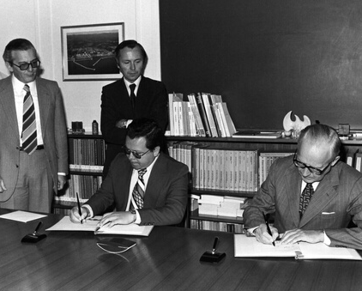
Signing of the Non-Proliferation Treaty (NPT).
Formation of the Warsaw Pact.
The Cuban Missile Crisis.
1960-1990
1952
1955
1950s-1970s
OCT 1962
1963
1968-70
Hydrogen bomb testing leads to protest.
The Vietnam War leads to large peace marches around the world, particularly in the US, alongside the civil rights movement
Tensions rise following the construction and fortification of the Berlin Wall.

Slide 3
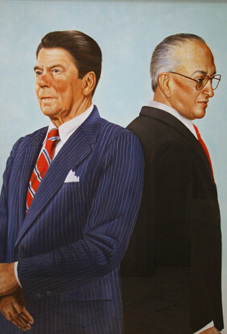
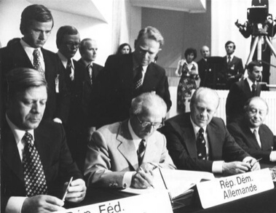
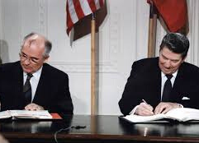
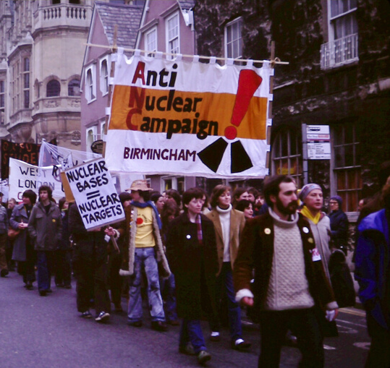
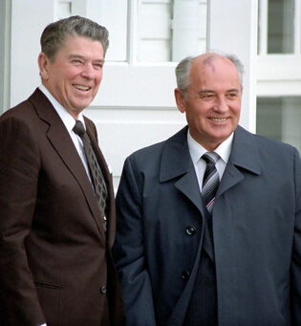
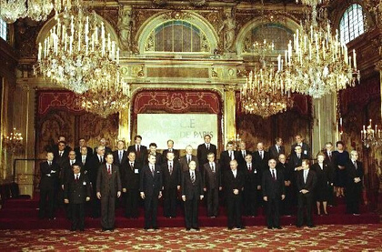
Gorbachev assumes power in the USSR and works with Reagan amidst peace movement activities.
The Charter of Paris for a New Europe seeks to integrate the Eastern bloc into a larger European cooperation.
NATO threatens to deploy new nuclear weapons in Europe as part of the "double-track decision".
1975-1990
1975
1979
1981
1985
1987-1988
NOV 1990
The Helsinki Accords are signed by countries of the Eastern and Western blocs.
The Intermediate-Range Nuclear Forces (INF) Treaty is signed by the USA and USSR and enters into effect
Ronald Reagan assumes office and a hardline policy against the USSR.

